Slide 1





Arresting Employee Attrition
IST 718 | 2020 Fall
Group 3
Jack O’Connor | Charlie Dvorak | Brian Hepp
Charlie Dvorak | Zakk Agrue | Zakk Agrue

Slide 2
People are leaving for four main reasons…
Problem
Analysis
Assessment
Recommendations
Can action plans be drawn to address high rate of attrition (people leaving – not retiring – for own reasons).
Hypothesis: The company can reduce attrition if leading factors can be identified and addressed
Data: HR records on 1470 employees (230 who left) with 35 attributes
Based on data modeling,
All ages are impacted in some way
Attitudes (what is or is not bothering someone) are not uniform
Being overtime eligible is a leading cause of attrition
Based on segmentation of those who leave
Young people, happy but moving-on
25-40 y.o. not engaged with job
25-40 y.o. not happy in/out of work
Older people, happy but plateaued
Do not abuse overtime
Listen to the employee survey
Ensure singles feel welcomed
Ensure young people see opportunities for growth
Find ways to keep jobs fresh for plateaued workers
Notes:
This is more a part of a formal presentation to be given to a client’s exec… An executive summary
We discuss everything in the slides to come, so I would use this as nothing more than a “10 second” table of contents…. Topics to come

Slide 3
Project Goals and Data
The company feels its attrition rate – those who are leaving on their own (not retiring) – is too high.
HR would like to have its employee records analyzed to assist in creating action plans to address the factors that may be encouraging employees to leave.
HR provided 1470 records that describe
Demographic data | 6: e.g., age, marital status, education
Firmographic | 3: department, job level, job role
Job Content | 3: travel level, overtime, standard hours
Monetary | 6: e.g., pay rates, stock options, pay hike
Work History | 8: e.g., years working, years w/company
Attitude measures | 5: e.g., satisfaction w/ job, work/life bal.
Non-informative | 3: e.g., employee ID
Status | 1: Attrition (left?) Yes/No
Notes:
This introduces the project… don’t repeat if you spend too much time on prior slide
Mention that attrition is leaving when company preferred they stayed

Slide 4
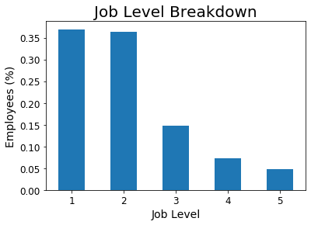
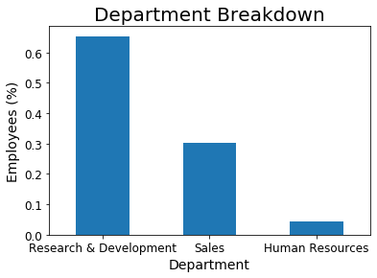
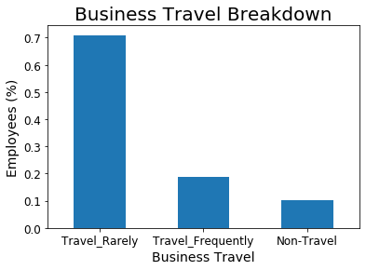
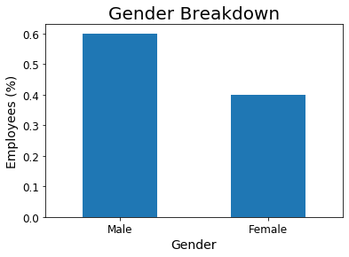
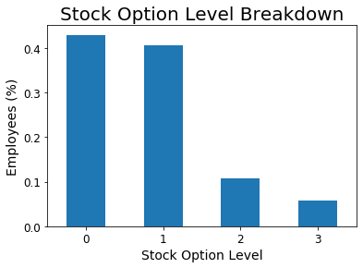
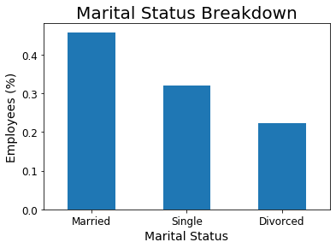
Demographics Reflect Company’s Science Focus
Notes:
This would be a quick presentation in how the company is structured… heavy in entry-level research jobs. As such, there tends to be little travel, and it happens that our workforce tends to be male and married
Note – did not mention anything about age here…. That is next slide

Slide 5
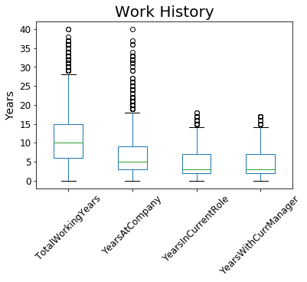
Workforce Shades Toward New and Young
The work force is
Relatively young (mean experience: 10 years)
Relatively new (mean tenure: 5 years)
Recently positioned (mean time in job: ~3 years)
However, the company is established, and some individuals have >40 years of tenure
Notes:
This slide looks that the range of work histories. Tends to be people on the early half of their career but includes some people with heavy tenure

Slide 6
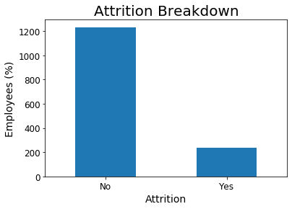
Company Attrition Rate is 16%
‘Attrition’ is defined as leaving the company as a personal decision prior to retirement
HR’s workforce records indicate 237 out of 1470 (16.1%) individuals fall into this category
Notes:
Introduces the problem….
while the company is heavier on people in their first half of their careers, the company would like to be a place where people can put in a whole career (okay… I am making up part of the back story, but that is why we are doing project)
1 in 6 is choosing not to stay and the company wants to know why.
Point out to audience that as we would like to model the data to understand why people are leaving, this slide also introduces our first analytical problem… that we have a very imbalanced dataset … can then hand off to jack

Slide 7
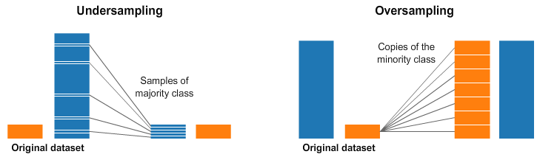
Key Finding: Data Imbalance Needs Correcting
Modeling techniques generally work best when there are equal numbers in groups under analysis.
There are generally two ways of handling the imbalance:
Notes:
Jack – Imbalanced data set: 1470 total observations, 1233 (~84%) have not left the company, 237 have left the company.
Two Options:
Undersampling: happens to the majority class. You only take a sample that equals the number of observations in the minority class (or to what percentage you need)
Oversampling: happens to the minority class. You can either copy the data that you have in the minority sample or use another technique to make the classes even.

Slide 8
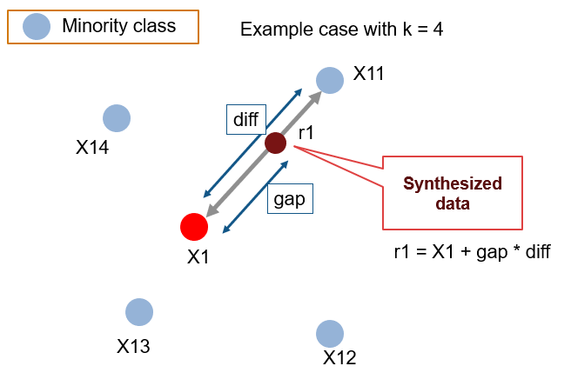
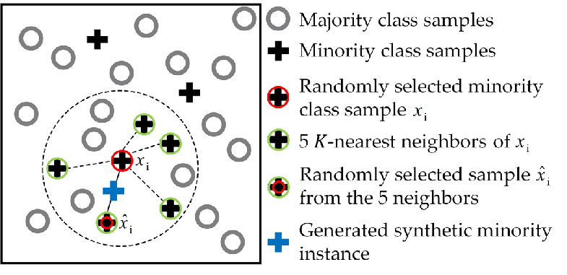
Project Selected To Balance Data with SMOTE
Synthetic Minority Oversampling Technique (SMOTE)
Rather than just copying existing records, create new ones in feature space
Notes:
Jack – We chose to use Smote which is an oversampling technique that synthetically creates additional samples for the minority class.
It does this by randomly selecting an observation from the minority class. It then finds that observation's k-nearest neighbors (we used 5). One of these neighbors is selected at random and a synthetic observation is created in the middle of those two observations. The algorithm does this until we had the same number of people who left the company as people who stayed at the company.

Slide 9
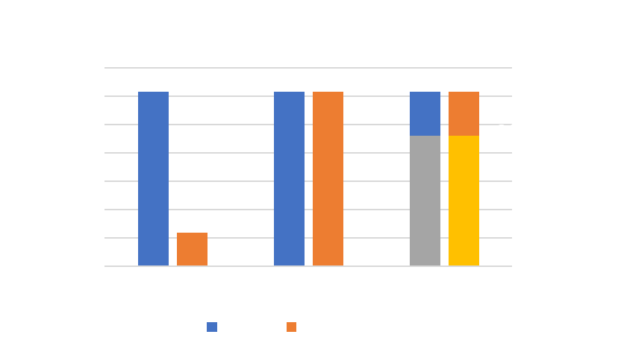
Analysis Strategy: Balance with SMOTE, Use Multiple Classifiers
Analysis Step | Strategy
Data Prep | SMOTE with no under-sampling of ‘Stay’ cases
Model Construction | Several classifiers and ‘average’ results
Measure | Accuracy (Precision, Recall, F1)
Method | Approach/Parameters
Random Forest | Parameter space (# estimators, max depth) explored with grid search with cross validation (n=5)
Naive Bayes | Default parameters
Support Vector Machine | cv=2 folds, kernel = linear, parameter grid search (C, gamma)
Gradient Boost | 1500 estimators, max depth of 4
Notes:
This slide is just 15-20 seconds recap of our sampling plan and an introduction of the methods we considered.

Slide 10

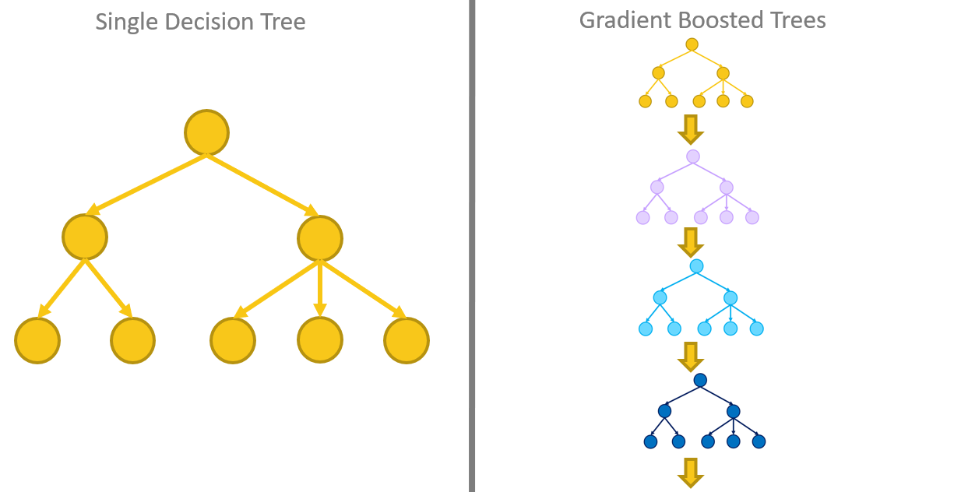
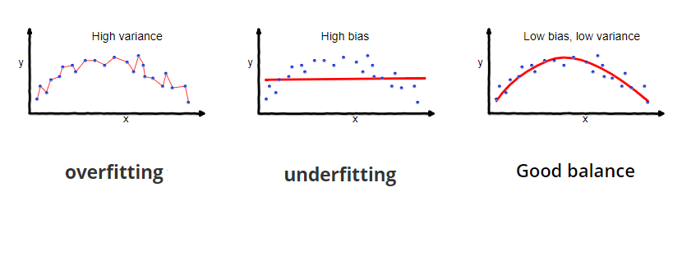
Random Forest vs. Gradient Boosted Classifiers
Both method use many trees to analyze the data
Random forest uses many independent, fully-developed trees (low bias, high variance) to make many predictions using the overfitted trees.
Gradient Boosted use weak learner trees that have a high variance with a low bias. Initial trees are used to compute log(odds) of an instance which are then used to develop subsequent trees.

Slide 11

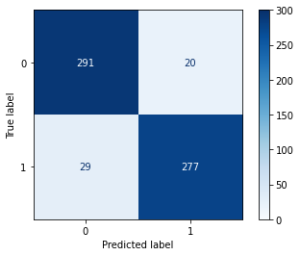
Classifier: Random Forest (92.1% accuracy)
Training Time
52.6s
Method | Parameters [Grid search range]
Random Forest | 'n_estimators’: 200 [100,200,300,400,500], 'max_depth’: 10, [2,5,10], cv=5

Slide 12
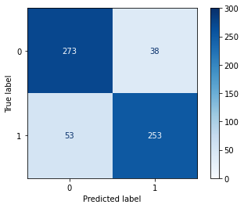
Classifier: Bernoulli Naïve Bayes (85% accuracy)
Training Time
0.01s
Method | Parameters [Grid search range]
Bernoulli Naive Bayes | (default parameters)

Slide 13
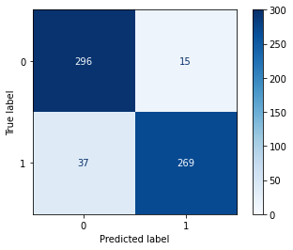
Classifier: Linear Support Vector Machines (92% accuracy)
Training Time
2.61s
Method | Parameters [Grid search range]
Linear SVC | C: 0.8 [0,1,.2] , loss: squared_hinge [hinge, squared_hinge], penalty: l1 [l1,l2]

Slide 14
Model: ‘Averaging’ not Effect Here
Original Intent was to develop several classifiers and have an ‘average’ (or ‘majority rule’) result
However, errors were sufficiently distributed that no ‘committee of 3’ exceeded 92% accuracy
Notes:
15 seconds to say
3 were in area of 91-93% accurate (Gradient Boosted 93%, RF 92.1%, NB 85%, SVM 92%)
I would point out that this is on the SMOTE dataset, which means these numbers compare to 50% for pure guessing
Point out that combining results did not improve results… taking average response of three methods still was only 92% accurate

Slide 15

Classifier: Gradient Boost (93% accuracy)
Training Time
2.23s
Method | Parameters [Grid search range]
Gradient Boost | 1500 estimators, max depth of 4
Notes:
Quick demonstration that the results were pretty balanced and move on

Slide 16
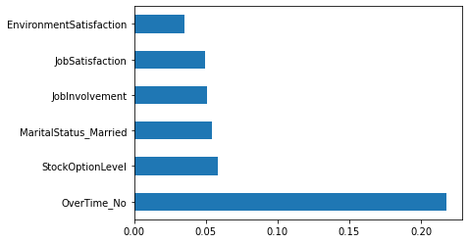
Overtime Eligibility is a Leading Issue
Based on the Gradient Boost (Random Forest, Naïve Bayes agree), overtime eligibility is a key indicator someone may leave.
Most Informative Features in Decision to Leave
After overtime, leading factors include
marital status
monetary incentives
attitude
Notes:
Points to bring up on this slide
Overtime is a big issue. One can see on the graph that about 30% of the people are eligible for overtime in the company, but 50% of those leaving are overtime eligible
Mention we do not have timecard data, so we cannot say how many OT hours people are putting in…. Only that those who are leaving are disproportionately those who might be putting in OT
Point out that other leading issues appear to be (see bullets on graph)

Slide 17
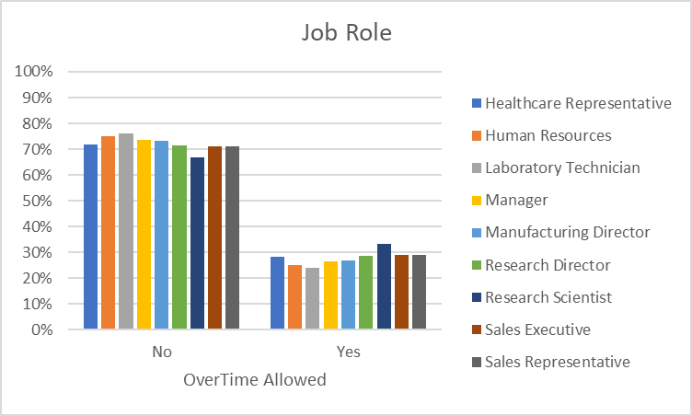
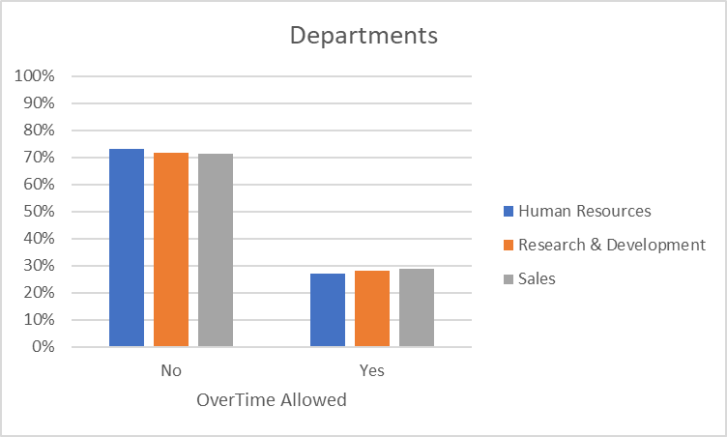
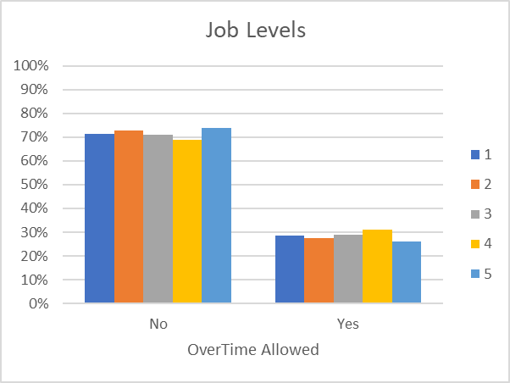
Overtime Is Not Concentrated in Any Part of the Company
‘Overtime’ is not a surrogate for company structure….
It is used across departments, job levels, and job roles (though a little less evenly)
Notes:
This slide is to show that ‘overtime eligible’ is not equivalent for young, entry-level people. It is actually used across the departments, roles, and job levels pretty similarly, even up to the top job level.

Slide 18
Singles are Disproportionally Leaving
Singles are
32% of our sample, but
50% of those who are leaving
However, it is not because overtime eligibility is falling disproportionally on our single workers. Eligibility is uniformly distributed across marital status
Notes:
We are also seeing singles are disproportionately leaving. Like overtime, singles are 50% of those who are leaving, but it is not because singles are disproportionally eligible. In fact, OT eligibility is split quite uniformly distributed based on marital status.

Slide 19
It is not Just the ‘Young’ Singles Who are Leaving
For individuals 25yo+, the age groups have similar distribution of marriage status
However, the singles in the 25-35 y.o. demographic are over-represented (25% of total)
Notes:
We also see that marital status is proportionately distributed across age groups too. What is worthy of noting is that we have a problem of our 25-34 y.o. singles are overly represented in those who are leaving

Slide 20
We Need to Watch our New and Mid-Level People
Entry-level individuals have a higher level of turn-over
We also have a spike of individuals leaving within our mid-level rank
What is interesting is maxing out the stock plan does not seem to encourage individuals to stay
Notes:
What we also notice is that we have what appears to be a spike in our mid-level managers leaving (top graph) and it does not seem to be the compensation as represented by the stock options. In fact, in this subgroup, those at the highest stock option are the most likely the ones who left.

Slide 21
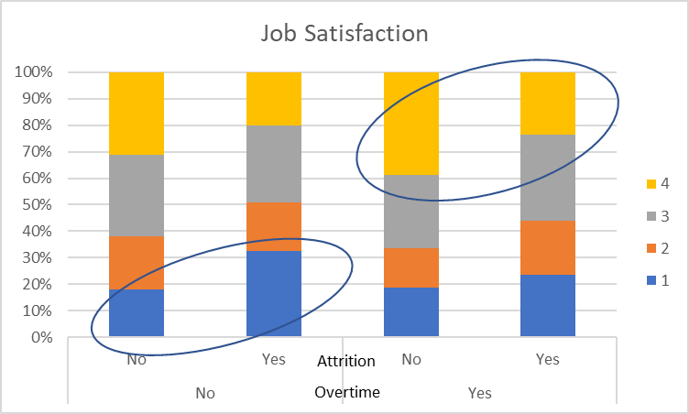
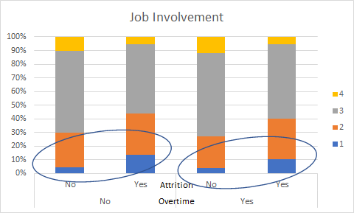
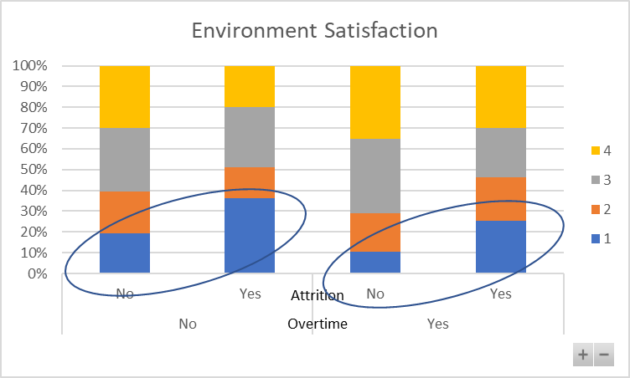
We Do See Some Trends in Attitudes in Employee Survey
Employee Surveys include five questions on attitude.
They do appear to be capturing indicators of problems.
Notes:
Then finally, the company has run an employee survey and we can see in some of the questions about satisfaction that we do see differences between those who stay and those who go… so we do have indicators that someone might be thinking of leaving.
And that leads us to our segmentation of those who have left.

Slide 22
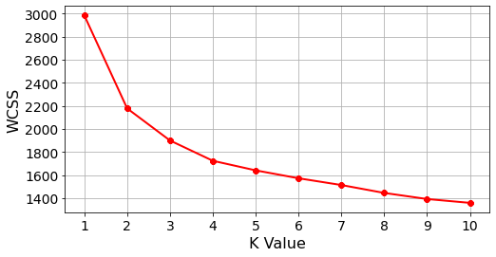
Next Step was to Segment Those who Left
Reducing to the GB model to key attributes still captures most of the accuracy (88% compared to 92%)
Used Kmeans Clustering to produce segment
Optimum segmentation is n=4
Attribute Type | Attributes
Demographic | Age Bracket Gender Marital Status
Firmographic | Job Level Overtime Eligible Stock Option Level
Attitude (Employee Survey) | Environment Satisfaction Job Involvement Job Satisfaction Relationship Satisfaction Work/Life Balance
Notes:
We selected the top influencers from the GB modeling, and when we model only on those attributes, we still achieve almost 90% accuracy, so we felt good using these attributes in our segmentation.
The segmentation was completed using Kmeans clustering, and those familiar with the technique will recognize the elbow chart.
within cluster sum of errors(wcss) is the total sum[“distance of every datapoint to its own center”^2]… also called inertia
Something to remember… inertia has two main problems
Inertia is a metric that assumes that your clusters are convex and isotropic, which means that if your clusters have elongated or irregular shapes this is a bad metric;
Inertia isn’t normalized, so if you have space with many dimensions you’ll probably face the “dimensionality curse” since the distances tend to get inflated in multidimensional spaces.
There is also a definition of the optimum number of clusters.. Did not specifically use it… tried 3 and 4 and found 4 to be informative

Slide 23
Segment Characterization was Based on Clusters’ Mean Values for 11 Attributes
Below are the mean values of a segmentation on the key attributes using n=4. Results are compared to those who stayed.
 | Stayed | Left |  |  |  |  | Code Definitions and Total Sample Count
 |  | MovingOn | Checked-Out | Disgruntled | Plateaued |  | Overtime |  | Count |  | Ages |  |  | Count
Age Bracket | 7.511 | 5.273 | 6.127 | 6.106 | 9.589 |  | 0 | Not Eligible | 1054 |  | 3 | 15 to 19 |  | 17
Gender | 0.594 | 0.745 | 0.557 | 0.596 | 0.661 |  | 1 | Eligible | 416 |  | 4 | 20 to 24 |  | 80
Marital Status | 1.045 | 1.600 | 1.253 | 1.468 | 1.214 |  |  |  |  |  | 5 | 25 to 29 |  | 229
Job Level | 2.146 | 1.236 | 1.519 | 1.340 | 2.446 |  | Gender |  |  |  | 6 | 30 to 34 |  | 325
Overtime eligible | 0.234 | 0.636 | 0.506 | 0.468 | 0.536 |  | 0 | Female | 588 |  | 7 | 35 to 39 |  | 297
Stock Option Level | 0.845 | 0.327 | 0.595 | 0.340 | 0.786 |  | 1 | Male | 882 |  | 8 | 40 to 44 |  | 208
Environment Satisfaction | 2.771 | 3.200 | 1.316 | 3.574 | 2.429 |  |  |  |  |  | 9 | 45 to 49 |  | 141
Job Involvement | 2.770 | 2.491 | 2.367 | 2.681 | 2.625 |  | Marital Status |  |  |  | 10 | 50 to 54 |  | 104
Job Satisfaction | 2.779 | 3.436 | 2.165 | 1.553 | 2.714 |  | 0 | Divorced | 327 |  | 11 | 55 to 59 |  | 64
Relationship Satisfaction | 2.734 | 2.836 | 2.443 | 2.128 | 2.982 |  | 1 | Married | 673 |  | 12 | 60 to 64 |  | 5
Work/Life Balance | 2.781 | 2.618 | 2.722 | 2.553 | 2.696 |  | 2 | Single | 470 |  | 13 | 65 to 69 |  | 0
Notes:
This is a matrix that shows how the means compare for each of the attributes and for those who stayed. What is interesting to see is where some group is high within the listed ranges (green) low in the range (red) or somewhere in the middle (yellow). When we look at how these four clusters varied, we see four subgroups.
Note that red = low, not necessarily bad

Slide 24
Who is Leaving? The Moving-On, Checked-Out, Disgruntled, and Plateaued Worker
Moving-On (67) Young, low-level employee with high overtime eligibility. Tends to be single male and reasonably happy with job.
Check-Out (50) 25 to 40 y.o., mid-to-low job level and very unhappy with work environment. Tends to be female and positive on work/life balance, partially because of a low involvement with the job.
Disgruntled (70) 25 to 40 y.o., more likely to be single, male, and in mid-to-low level job. Happy with work environment, but very unhappy both at work and at home.
Plateaued (50) Older individual in a mid-to-high level position. Tends to be happy at work and in relationships

Slide 25
Recommending Five Areas To Examine
Issue | Action Plans to Consider
Is overtime being misused by the company/ managers? | About ~30% of the workforce is overtime eligible, but ~50% of those leaving are eligible. Are these employees being asked to carry too much work burden?
Is the employee survey being used? | Survey results are indicating dissatisfaction among some who ultimately leave. Is HR using the employee survey to generate action plans to address needs?
Is the company too marriage/ family focused? | Singles are disproportionately leaving. Has the company become so ‘family friendly’ that singles do not feel engaged (e.g., in community, in company)?
Is the company keeping opportunities in front of the young? | Young workers are happy but leaving. Are they finding better opportunities outside the company? Is company laying out a roadmap for their development and advancement?
Is company keeping mid-level managers engaged? | There is a general trend of decreasing attrition with increasing job level, but there is a spike at job level 3. Is the company doing enough to keep people interested in the company who have hit a career plateau?

